Slide 1
Project 2
Presentation
on
BRAIN TUMOR CLASSIFICATION USING MR IMAGES AND TRANSFER LEARNING
ECM-A Batch-3
G.Shirisha (19311A1914)
A.Mani chandana (19311A1927)
B.Ankitha (19311A1956)
Internal guide:
Dr.MANU GUPTA

Slide 2
CONTENTS
Abstract
Introduction
Literature survey
Existing methodology
Proposed system
System implementation
Results
Conclusion
References

Slide 3
ABSTRACT
A brain tumor can be expressed as a tissue that occurs in a place where it should not be in our brain or an uncontrolled growth of any tissue.
We profound learning show for classification of brain tumor from MRI pictures utilizing Transfer learning is displayed.
The profound brain MRI highlights are extricated utilizing the pre-trained demonstrate VGG16 and InceptionV3.

Slide 4
INTRODUCTION
There are several medical imaging techniques used to acquire information about tumors (tumor type, shape, size, location, etc.), which are needed for their diagnosis[2]. MRI is often used to detect brain tumor because it shows the brain more clearly than do other imaging tests.
Proposing a Transfer leaning model for tumor detection has several benefits. Firstly, transfer learning models can detect subtle changes in medical images that may be missed by the human eye, increasing the accuracy of diagnoses[4].
Secondly, these models can analyse large amounts of medical data quickly and efficiently, which can reduce the time and resources needed for tumor detection[10].
Additionally, transfer learning models can be trained to detect various types of tumors, which can help doctors diagnose and treat different types of cancer more effectively.

Slide 5
LITERATURE
Title of the paper | Methods used | Accuracy | Advantages | Disadvantages
[1] Detection of tumors on brain MRI images using the hybrid convolutional neural network architecture Year : 2020 | Resnet50 model | It is 97.01% accurate. | Improved accuracy compared to other architecturesand utilizes the strong feature extraction capabilities of ResNet50. | The model used in this paper has limited evaluation metrics.
[2]Detection of brain abnormality by a novel Lu-Net deep neural CNN model from MR images Year : 2020 | Novel CNN model(LU-Net) | It has an accuracy rate of98%. | This system has highaccuracyand outperforms other models. | There is a limited scope for the model used
[3]Brain tumor detection in MR image using superpixels, principal component analysis and template based K-means clustering algorithm Year : 2021 | Super pixels and Principal Component Analysis (PCA),TK-means clustering | It has an accuracy rate of95% | Here,the system has superior Performance. | The main disadvantage is lack of Deep Learning Integration: Although the study suggests incorporating a deep learning system, it was not utilized in the proposed scheme

Slide 6
Title of thepaper | Methods used | Accuracy | Advantages | Disadvantages
[5]Early tumor diagnosis in brain MR images via deep convolutional neural network model Year : 2021 | Deep-CNN based model | It is 98% accurate | The proposed system has Higher accuracy and it Overcomes overfitting | The system is limited to classification of normal and abnormal tumor and has more computational time
[6]BrainMRNet: Brain tumor detection using magnetic resonance images with a novel convolutional neural network model Year : 2020 | BrainMRNet model | The study reports a classification success rate of 96.05% | Superior classification accuracy and has Residual blocks which Minimizes the negative effects of depth on model performance improves the overall accuracy. | The system has lack of further classification and limited dataset
[7]Brain tumor identification and classification of MRI images using deep learning techniques Year : 2020 | Fully Automatic Heterogeneous Segmentation using Support Vector Machine (FAHS-SVM) method | The has an accuracyrate of 98.51% | Promising results on multi-parametric Magnetic Resonance image. | The system used has limited evaluation and limited generalizability to different datasets or imaging techniques.

Slide 7
EXISTING METHODOLOGY
Traditionally,Convolutional neural network (CNN) model using a large dataset involves a significant level of computational complexity.
Reusing the model weights from previously trained models might therefore streamline this learning process.
Disadvantages:
Poorer output
Significant degree of computational complexity.

Slide 8
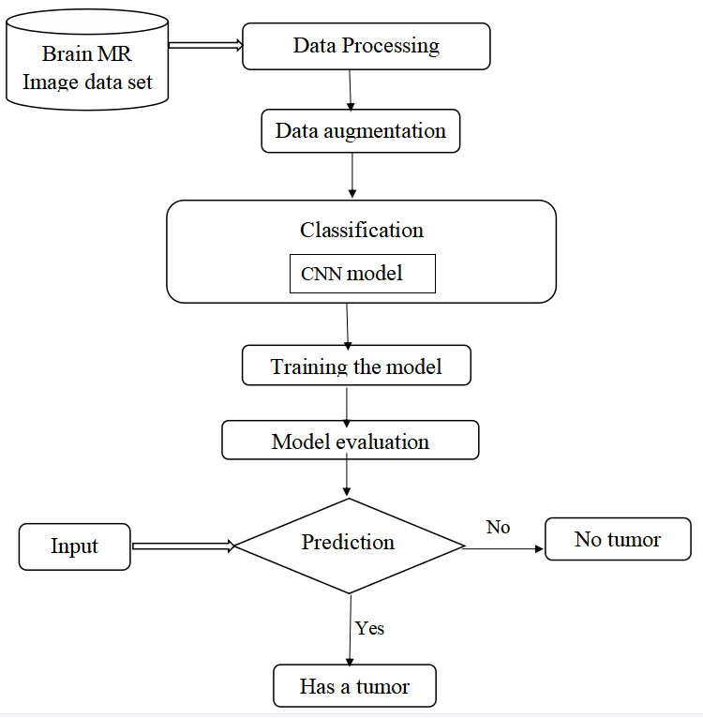
Existing model Block diagram

Slide 9
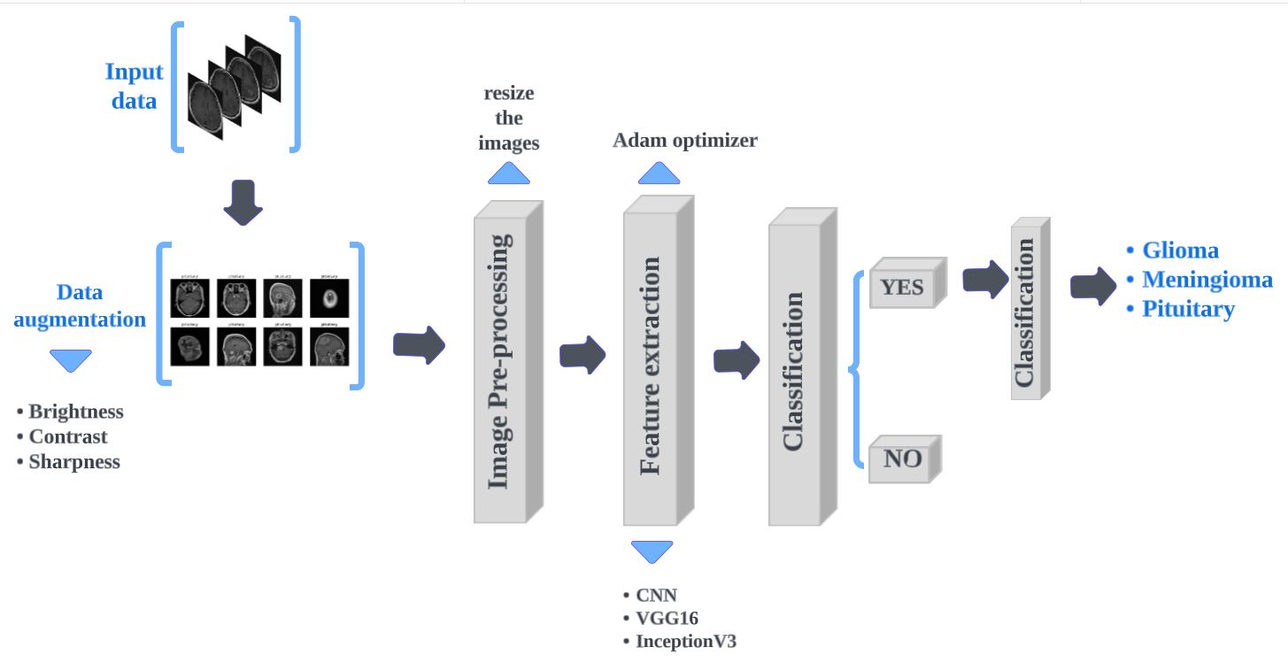
Proposed System
Block diagram

Slide 10
Model Implementation
Loading the dataset: The first step is to load the dataset into memory. This can be done using Python libraries such as NumPy or Pandas. The dataset should be divided into training and test sets.
Augmentation and image pre-procesing: Data augmentation techniques such as and cropping can be used to artificially increase the size of the dataset and reduce overfitting. This step can be done using Python libraries such as Keras or OpenCV.
Feature extraction: Feature extraction involves extracting important features from the images that can help in distinguishing between different types of tumors. This can be done using pre-trained models such as VGG16 or InceptionV3, which have been trained on large datasets of images and can extract meaningful features from the input images.
Classification: Once the features have been extracted, a classification model can be trained to classify the images into different tumor types.
Further classification of tumor type: After the images have been classified into different tumor types, further classification can be done to identify the specific type of tumor.
Overall, this process involves loading the dataset, augmenting the data, extracting important features, classifying the images to identify if there is a tumor or not, and further classifying the specific types of tumor if there is a tumor. This process requires a combination of image processing, machine learning, and deep learning techniques and can be computationally intensive.

Slide 11
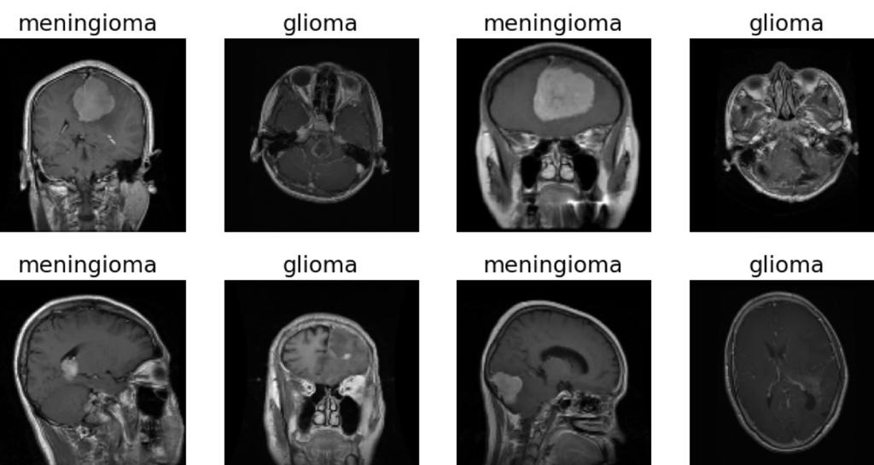
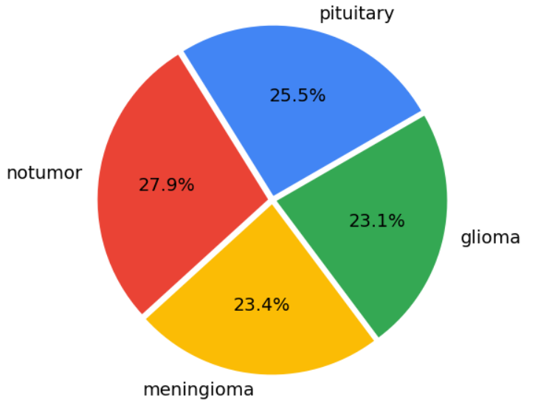
Data Description
There were 4 distinct classes in the dataset — Glioma, Meningioma, Pituitary Tumor, and a baseline case of No Tumor. The dataset consists of 5,712 images in the training set and 1,311 images in the test set.
Sample Images:

Slide 12
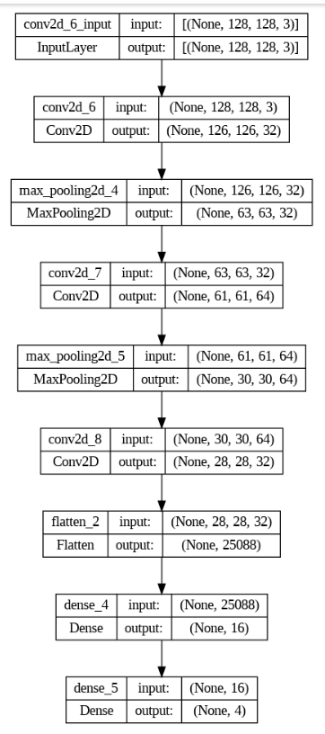
CNN Model
Convolutional Neural Network consists of multiple layers of interconnected neurons.
Each layer of the network contains multiple neurons.The connections between neurons are represented by weights.
The network is trained using the backpropagation algorithm, which adjusts the weights and baises.
CNN Architechture

Slide 13
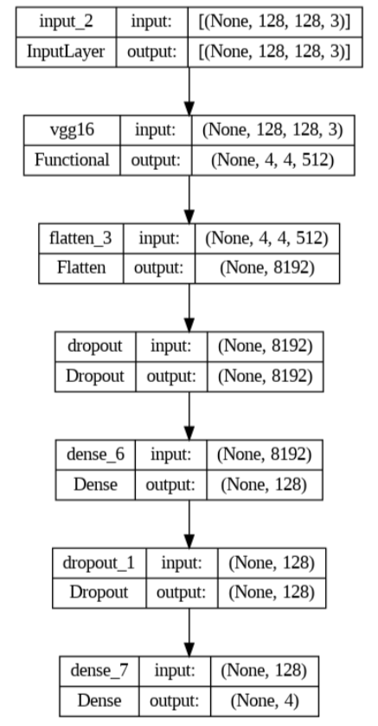
VGG16 Model
VGG16 has 16 layers, including 13 convolution layers and 3 fully connected layers.
The convolution layers in VGG16 have a small receptive field of 3x3 pixels.
VGG16 uses max pooling with 2x2 filters size and a stride of 2 to downsample the features maps and reduce the dimensionally of input.
Input image size is 224x224 in RGB format.
Vgg16 architechture

Slide 14
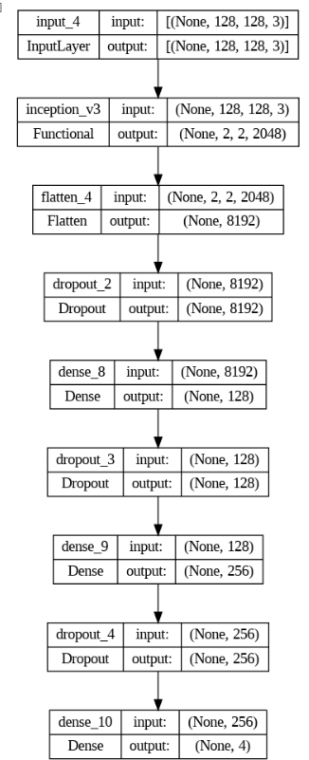
InveptionV3 Model
It has 48 layers.Input images of size 229x229 pixels.
Uses auxiliary classifiers at intermediate layers of the network to encourage to learn more discriminating features.
Batch normalization is used to normalize the inputs to each layer.
InceptionV3 Architechture

Slide 15
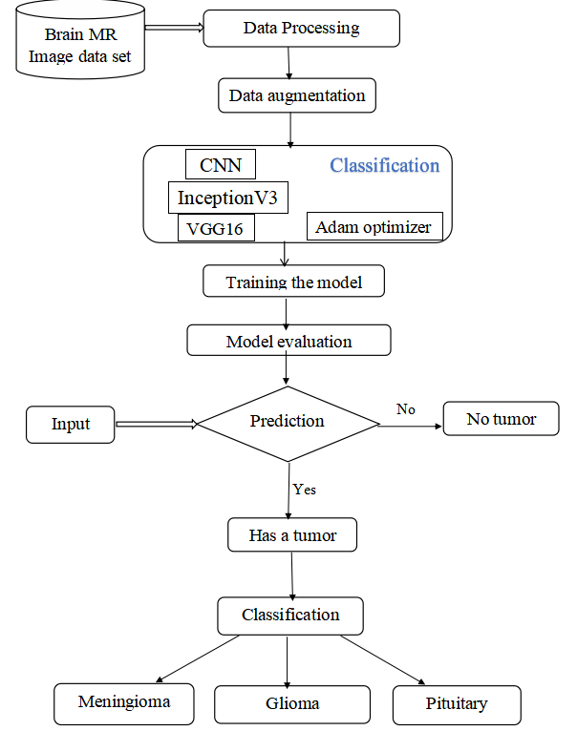
System Workflow

Slide 16
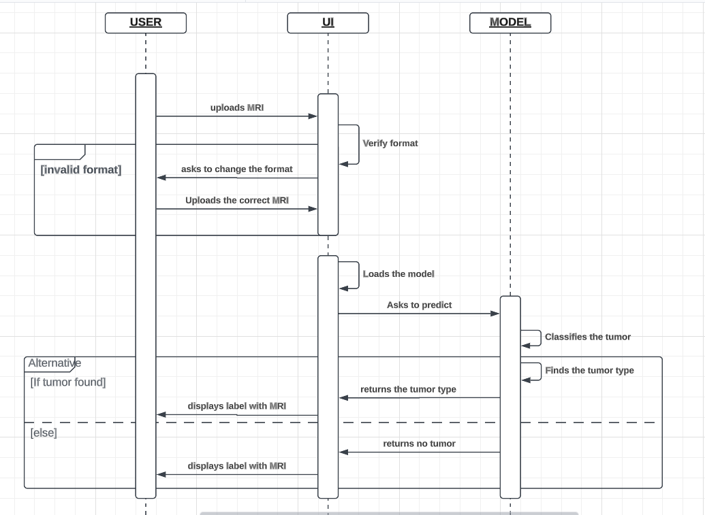
SEQUENCE DIAGRAM

Slide 17
Performance metrics
The metrics we have used for the evaluation of our model are:
Accuracy= (TN+TP)/ (TN+FP+FN+TP) (1)
Precision=TP/ (FP+TP) (2)
Recall=TP/ (TP+FN) (3)
F1 score= TP/ (TP+1/2(FP+FN)) (4)
Where,
TP = True-positive,
TN = True-negative,
FP = False- positive,
FN = False-negative

Slide 18
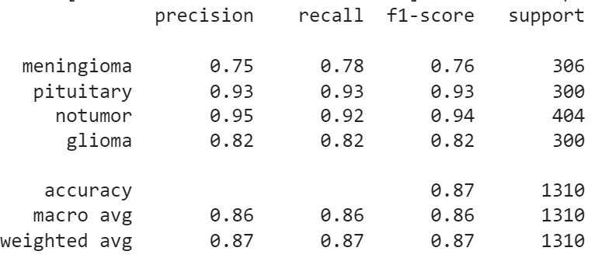
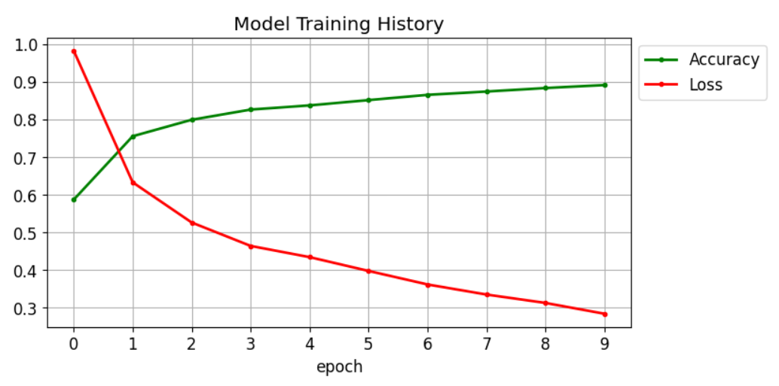
CNN Model Performance
These metrics are calculated during the training and evaluation of the model using the model.compile() and model.fit() functions, and are displayed in the output during the training and evaluation phases.
CNN Model Training History
CNN classification report

Slide 19
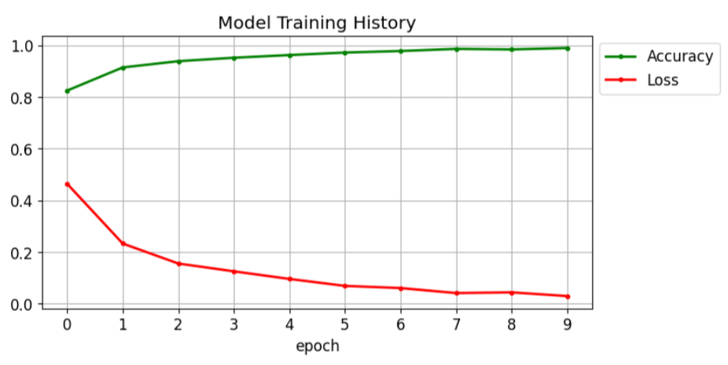
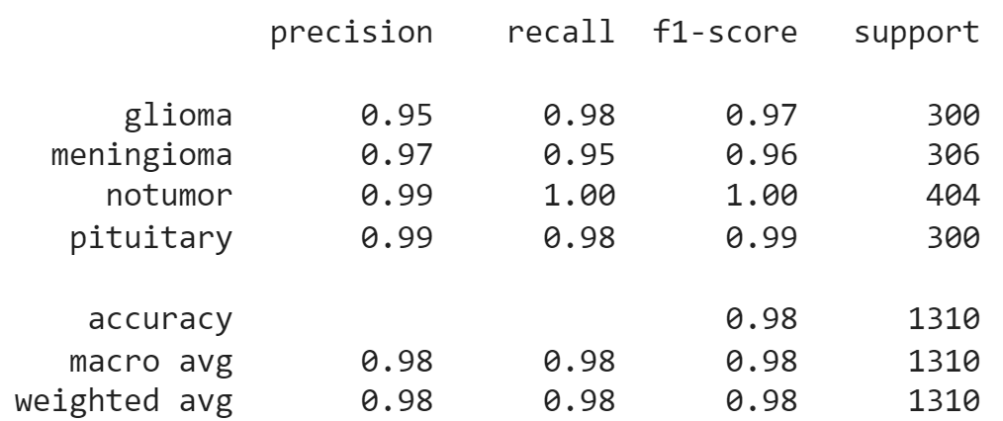
VGG16 Model Performance
VGG16 Training history
VGG16 Classification report

Slide 20
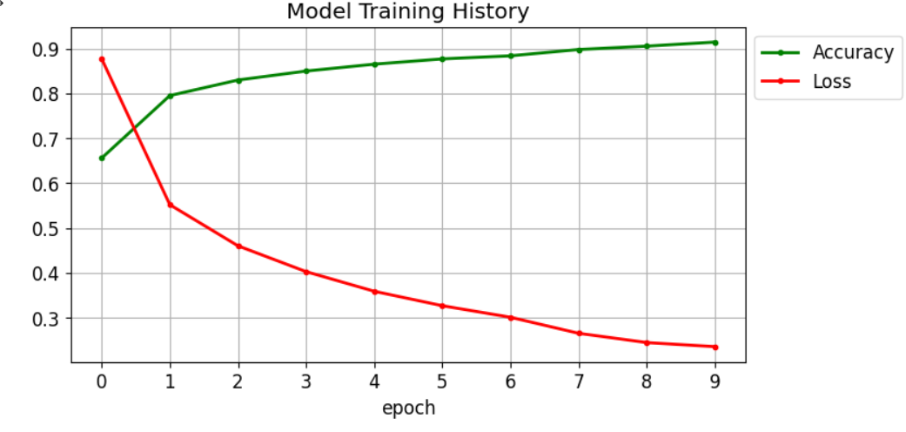
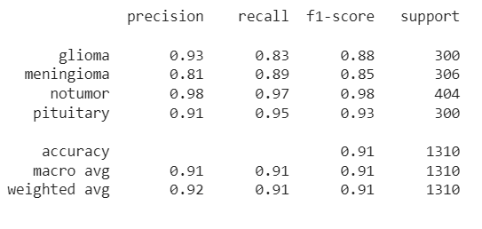
InceptionV3
InceptionV3 Training history
InceptionV3 Classification report

Slide 21
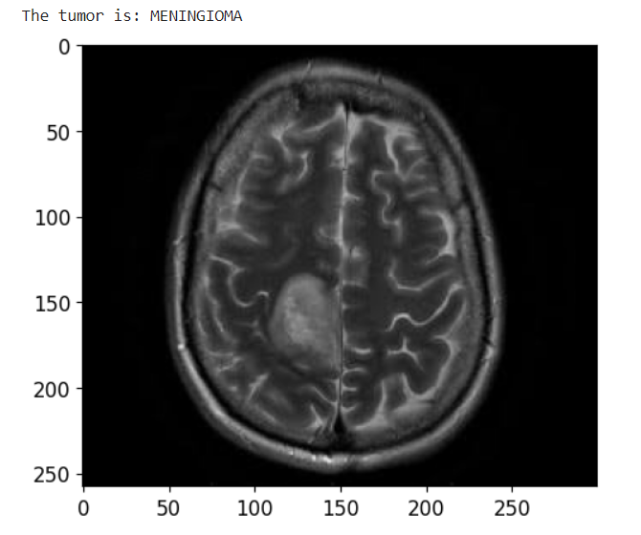
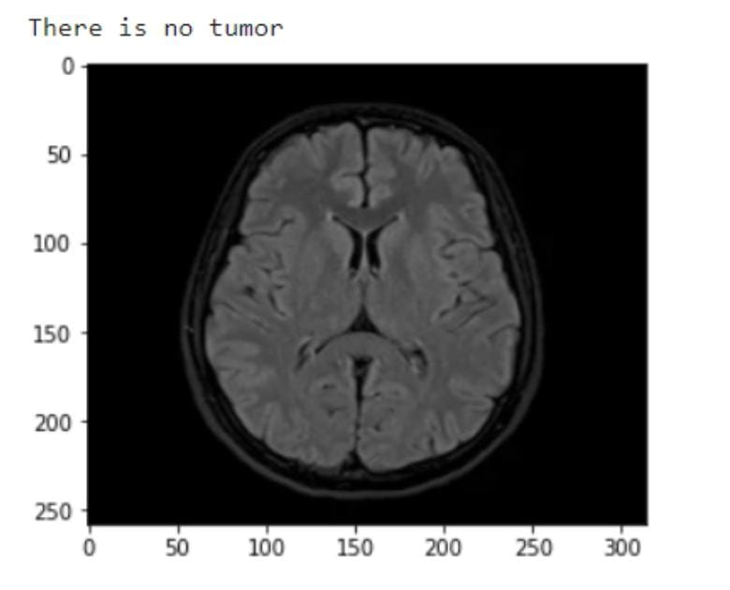
RESULTS
The MR image is predicted correctly as expected. The image is displayed after the prediction with the label on the top of the image as result.

Slide 22
Comparision of Results
Epochs | Three |  | Five |  | Seven |  | Ten
 | Time | Accuracy | Time | Accuracy | Time | Accuracy | Time | Accuracy
CNN | 165 | 75% | 175 | 80% | 179 | 80% | 171 | 86%
VGG-16 | 181 | 90% | 179 | 97% | 181 | 97% | 176 | 98%
InceptionV3 | 184 | 83% | 173 | 87% | 221 | 87% | 183 | 90%

Slide 23
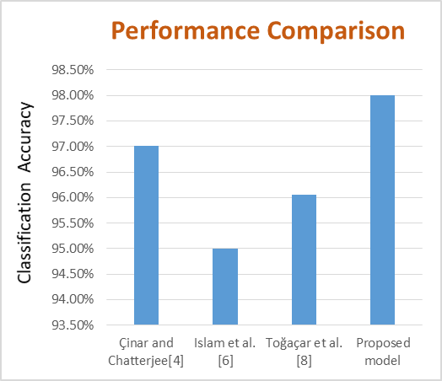

Slide 24
CONCLUSION
Within the proposed work, a model for brain tumor classification is displayed utilizing CNN and transfer learning procedures.
The outcomes proposed that VGG16 model gives way better comes about in comparison to CNN and InceptionV3 with accuracy of 98% on the test dataset.
This show is computationally successful, less time expending and gives strong design for classification of brain tumors.
In future scope, the tumor discovery can be performed utilizing multimodal MRI pictures for moved forward execution.

Slide 25
REFERENCES
[1] A. Çinar and M. Yildirim, ‘‘Detection of tumors on brain MRI images using the hybrid convolutional neural network architecture,’’ Med. Hypotheses, vol. 139, Jun. 2020, Art. no. 109684.
[2] H. M. Rai and K. Chatterjee, ‘‘Detection of brain abnormality by a novel Lu-Net deep neural CNN model from MR images,’’ Mach. Learn. Appl., vol. 2, Dec. 2020, Art. no. 100004.
[3] M. K. Islam, M. S. Ali, M. S. Miah, M. M. Rahman, M. S. Alam, and M. A. Hossain, “Brain tumor detection in MR image using superpixels, principal component analysis and template based K-means clustering algorithm,’’ Mach. Learn. Appl., vol. 5, Sep. 2021, Art. no. 100044
[4] R. Mehrotra, M. A. Ansari, R. Agrawal and R. S.Anand, “A Transfer Learning approach for AIbased classification of brain tumors,” Mach. Learn. Appl. 2020, 2, 10–19.
[5] T. K. Das, P. K. Roy, M. Uddin, K. Srinivasan, C.-Y. Chang, and S. Syed-Abdul, ‘‘Early tumor diagnosis in brain MR images via deep convolutional neural network model,’’ Comput., Mater. Continua, vol. 68, no. 2, pp. 2413–2429, 2021.
[6] M. Toğaçar, B. Ergen, and Z. Cömert, ‘‘BrainMRNet: Brain tumor detection using magnetic resonance images with a novel convolutional neural network model,’’ Med. Hypotheses, vol. 134, Jan. 2020, Art. no. 109531.
[7] Z. Jia and D. Chen, ‘‘Brain tumor identification and classification of MRI images using deep learning techniques,’’ IEEE Access, early access, Aug. 13, 2020, doi: 10.1109/ACCESS.2020.3016319.

Slide 26
REFERENCES
[8]N. Abiwinanda, M. Hanif, S. Hesaputra, A. Handayani, T. R. Mengko, “Brain tumor classification using convolutional neural network, “World Congress on Medical Physics and Biomedical Engineering, Springer, Singapore, 2019.
[9]S. Basheera, M. S. S. Ram, “Classification of brain tumors using deep features extracted using CNN,” J. Phys., 1172 (2019), 012016.
[10] M. Talo, U. B. Baloglu, O. Yldrm, U. R. Acharya, “Application of deep transfer learning for automated brain abnormality classification using MRI images, “Cognitive Systems Research, 54 (2019), 176–188.
[11] A. Rehman, S. Naz, M. I. Razzak, F. Akram, M. Imran, “A Deep Learning-Based Framework for Automatic Brain Tumors Classification Using Transfer Learning,” Circuits Syst. Signal Process., 39 (2020), 757–775.
[12] S. Preethi and P. Aishwarya, “Combining Wavelet Texture Features and Deep Neural Network for Tumor Detection and Segmentation Over MRI,”. J. Intell. Syst. 2019, 28, 571–588.
[13] Taher F, Shoaib MR, Emara HM, Abdelwahab KM, Abd El-Samie FE, Haweel MT,“ Efficient framework for brain tumor detection using different deep learning techniques”, Front Public Health. 2022 Dec 1.

